Slide 1

California Hospital Performance Comparison
Presented by Jenae Journot, Manuel Sosa and Greg Thomas

Slide 2
Project Background
For this project, our goal was to build an insightful dashboard including key data visualizations that hospital administrators in California could utilize when making operating decisions.
By analyzing and visualizing the revenue mix and types of care provided at each hospital, the user can uncover trends and insights about the current healthcare system operations in California.
We also analyzed data from both the ten largest and smallest hospitals – based on the size of their total assets – to provide a benchmark for comparison.

Slide 3
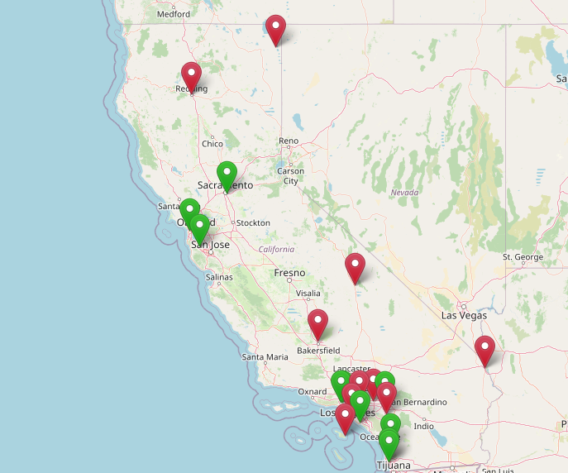
Largest and Smallest Hospitals
<<Add Analysis>>
Note for Greg:
Green = Ten Largest
Red = Ten Smallest

Slide 4
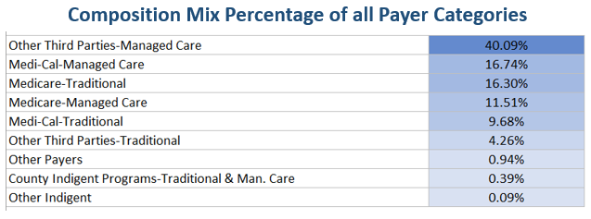
Mix of Pay Type
9 Payer Categories
431 Facilities
$16.5B in Combined Net Revenue
<<Add Analysis>>

Slide 5
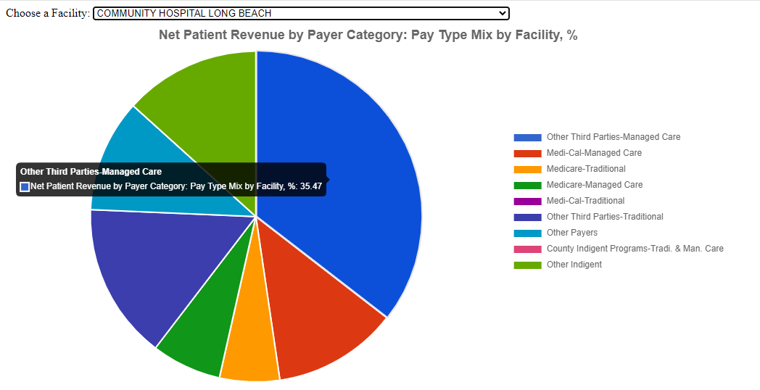
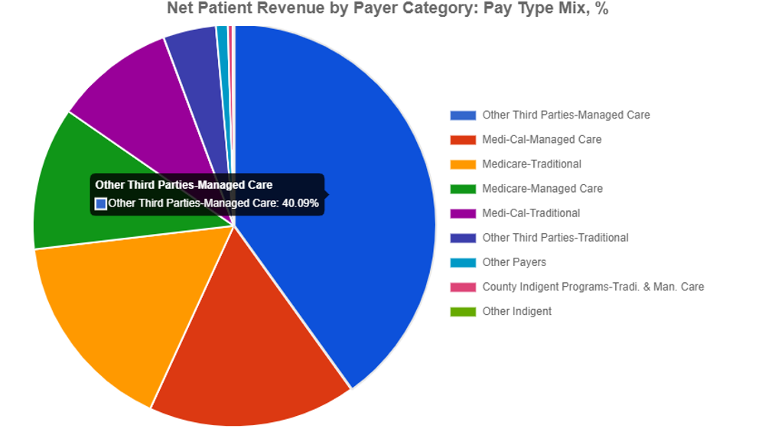
Net Patient Revenue by Payer Category

Slide 6
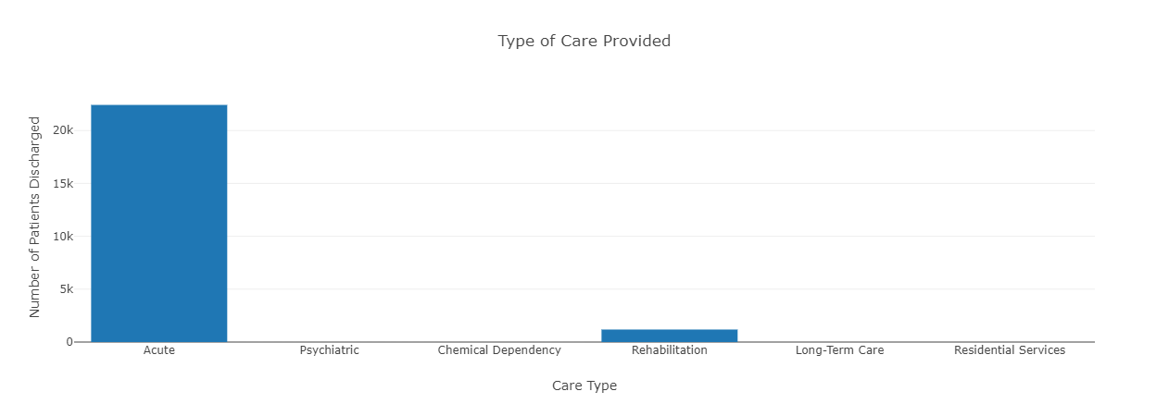
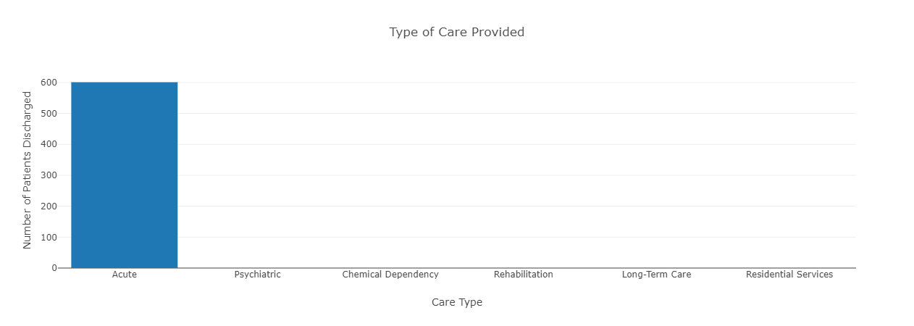
Type of Care
The type of care provided at each hospital varied. For most hospitals, the majority of care provided fell under Acute Care – which includes services like medical/surgical acute, obstetrics acute, definitive observation, medical/surgical intensive care, and coronary care.

Slide 7
Lessons Learned

Slide 8

Any Questions?

